Slide 1
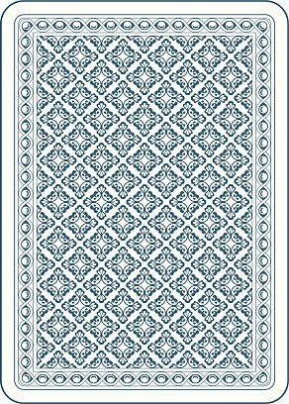
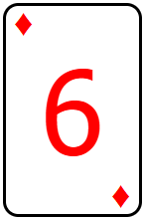
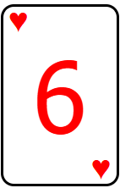
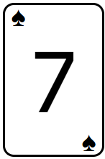
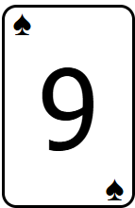
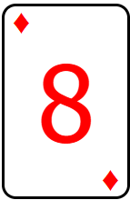
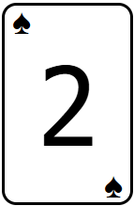
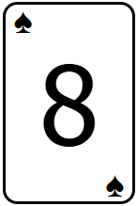
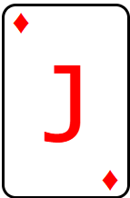
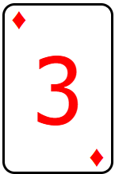
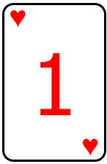
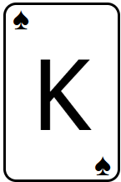

1. Deck is shuffled, then moved offscreen
4. Dealer draws a 6 and a face-down card
START OF ANIMATION
5. Player 1 hits, draws a 9 and busts with a value of 22, losing their chips
6. Player 2 hits, draws a 3 and stands with a value of 19
7. The current user is given the option to stand or hit
3. Cards are dealt as follows:
1: 6, 7; 2: 8, 8; 3: 1, K; 4: J, 2
Stand
1
Hit
2
3
(You)
4
2. Bets are placed as chips
Notes:
START OF ANIMATION
1. Deck is shuffled, then moved offscreen
2. Bets are placed as chips
3. Cards are dealt as follows:
1: 6, 7; 2: 8, 8; 3: 1, K; 4: J, 2
4. Dealer draws a 6 and a face-down card
5. Player 1 hits, draws a 9 and busts with a value of 22, losing their chips
6. Player 2 hits, draws a 3 and stands with a value of 19
7. The current user is given the option to stand or hit

Slide 2
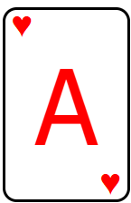
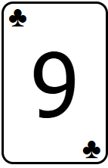
2. Dealer flips over the face-down card and reveals an ace, giving a value of 17 and forcing them to stand
IF THE USER STANDS
3. Player 2, with a total value of 19, receives a payout equal to their bet
4. The user, with a total value of 11, loses their bet
5. Player 4, with a blackjack, receives a payout equal to their bet
1
2
3
(You)
4
1. Player 4 hits and draws a 9, obtaining a blackjack
Notes:
IF THE USER STANDS
1. Player 4 hits and draws a 9, obtaining a blackjack
2. Dealer flips over the face-down card and reveals an ace, giving a value of 17 and forcing them to stand
3. Player 2, with a total value of 19, receives a payout equal to their bet
4. The user, with a total value of 11, loses their bet
5. Player 4, with a blackjack, receives a payout equal to their bet

Slide 3
IF THE USER HITS
1. The user hits and draws a 9, obtaining a value of 20
1
Hit
Stand
2
3
(You)
4
2. The user is given the option to stand or hit
Notes:
IF THE USER HITS
1. The user hits and draws a 9, obtaining a value of 20
2. The user is given the option to stand or hit

Slide 4
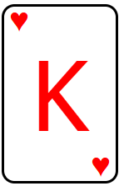
2. Dealer flips over the face-down card and reveals an ace, giving a value of 17 and forcing them to stand
IF THE USER HITS, THEN STANDS
3. Player 2, with a total value of 19, receives a payout equal to their bet
4. The user, with a total value of 20, receives a payout equal to their bet
1. Player 4 hits, draws a King and busts, losing their bet
1
2
3
(You)
4
Notes:
IF THE USER HITS, THEN STANDS
1. Player 4 hits draws a King and busts, losing their bet
2. Dealer flips over the face-down card and reveals an ace, giving a value of 17 and forcing them to stand
3. Player 2, with a total value of 19, receives a payout equal to their bet
4. The user, with a total value of 20, receives a payout equal to their bet

Slide 5
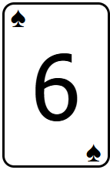
3. Dealer flips over the face-down card and reveals an ace, giving a value of 17 and forcing them to stand
IF THE USER HITS TWICE
4. Player 2, with a total value of 19, receives a payout equal to their bet
5. Player 4, with a total value of 18, receives a payout equal to their bet
1. The user draws a King and busts with a value of 30, losing their bet
2. Player 4 draws a 6 and stands with a value of 18
1
2
3
(You)
4
Notes:
IF THE USER HITS TWICE
1. The user draws a King and busts with a value of 30, losing their bet
2. Player 4 draws a 6 and stands with a value of 18
3. Dealer flips over the face-down card and reveals an ace, giving a value of 17 and forcing them to stand
4. Player 2, with a total value of 19, receives a payout equal to their bet
5. Player 4, with a total value of 18, receives a payout equal to their bet

